Slide 1
English - getting it right!
Some of the most common mistakes made in speaking and writing English

Slide 2
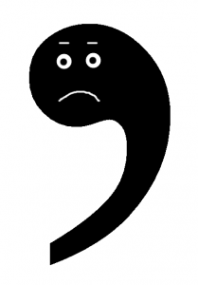
Apostrophes – tiny but important!
Just because a word ends in an ‘s’, that does not necessarily mean it needs an apostrophe. There are only two occasions when an apostrophe is needed : when ownership is indicated (Kevin’s house, Tracey’s bag) or a letter or letter has been left out (I couldn’t go because I was washing my hair, He wasn’t happy with the score).
Problems sometimes arise when plurals and ownership are involved at the same time. Just to be difficult, the apostrophe now goes after the ‘s’ (The girls’ toys, the parents’ ground rules)
It’s and its mean different things. It’s means ‘it is’ or ‘it has’. So far, so good.
Its means ‘belonging to something or someone’ e.g. The company opened its fifth store, the bird built its nest.

Slide 3
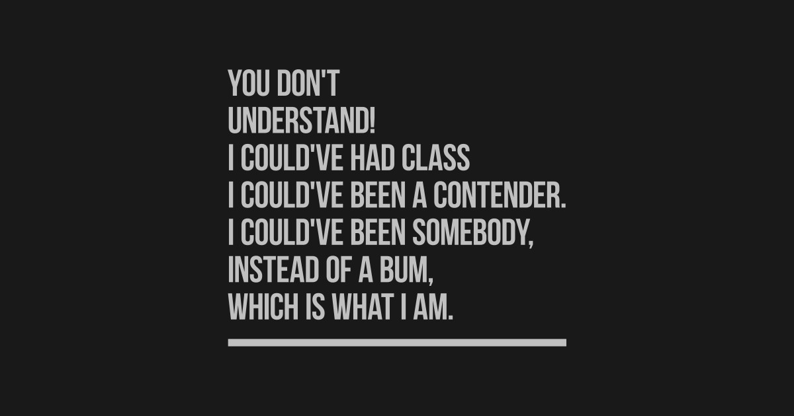
On the same subject….. Don’t confuse could’ve and could of
The same applies to should’ve, might’ve, would‘ve……
All that’s happened is the letters ‘h’ and ‘a’ have been omitted from the word ‘have’ (see previous slide). The result, when spoken, does indeed sound like of but when written like that, it’s meaningless.
So always write ‘could’ve’, ‘should’ve’, ‘might’ve’, ‘would’ve’ etc. if you’re using these short forms.

Slide 4
Me, myself and I
This tricky subject needs to have a power presentation its own, such a minefield has it become.
The word myself is nowadays for some reason seen as more sophisticated than the word me, when most of the time, it is absolutely fine. So avoid saying or writing phrases such as ‘Please contact John or myself if you would like to attend’ or ‘E-mail myself when you can’.
ME is fine.....but not when part of the subject of a sentence e.g. Mum and me went to the shops. It should be Mum and I went to the shops. If in doubt, try taking out the other names person - mum in this case. You wouldn’t say Me went to the shops, would you?

Slide 5
So can I ever use ‘myself’?
Of course!
It’s a reflexive pronoun, that is, it need only ever be used when you’ve already established yourself as the subject of the sentence.
Think about looking in a mirror and seeing your reflection. You’d say ‘ I see myself in the mirror,’. Other reflexive pronouns include himself, herself, yourself, itself, themselves and so on.
Examples of when to use myself:
I eat too much chocolate but I can’t help myself.
Some people like avocados but I myself hate them. ‘Why?’, I ask myself.
I am beside myself with worry.

Slide 6
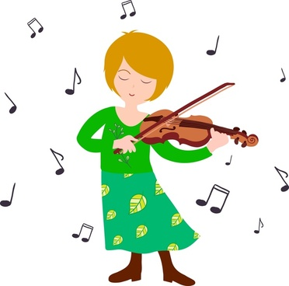
Practice or practise?
This is a spelling that just has to be learned!
Practise is a verb.
She practised her violin three times a week.
Practice is a noun.
He visited the doctor’s practice weekly.
Tip: if in doubt, think about ‘advise’ (verb) and ‘advice’ (noun) which sound different. ‘License’ and ‘licence’ follow the same spelling rule.

Slide 7
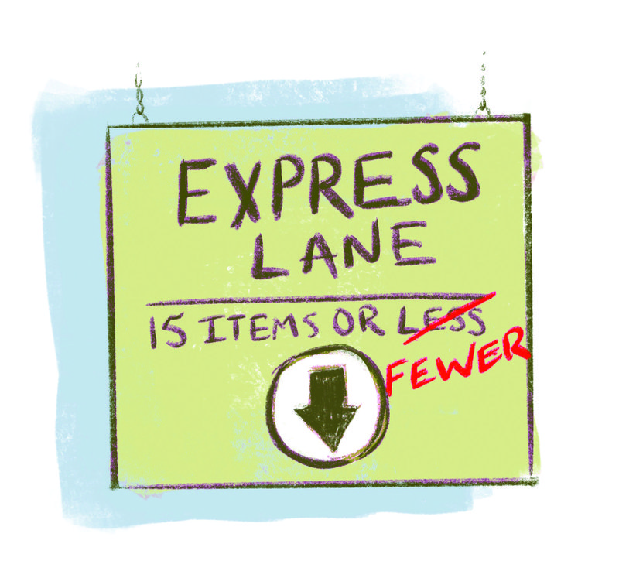
Less or fewer? Supermarkets often get this wrong
If you can count it, use fewer. If you can’t, use less e.g. I had less time than I thought, There were fewer than six items in my basket, so I headed for the express checkout.

Slide 8
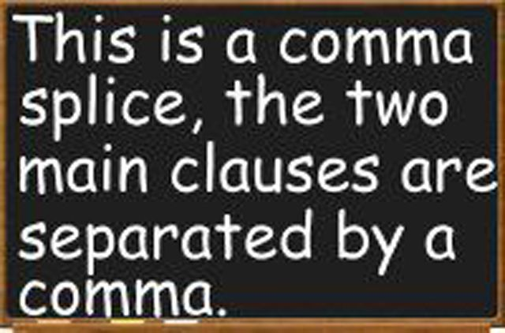
Run-on sentence syndrome: otherwise known as ‘comma splicing’
Always take care to show where one sentence ends and another begins. Every sentence should end with a full stop, exclamation mark or question mark NOT a comma.

Slide 9
When two words become one….
Common errors include alot instead of a lot.
Also be careful with these, which are all correct:
Under way
Every day (everyday is a word which means routine or commonplace)
In store
On site

